Slide 1

STRUCTURAL HEALTH MONITORING OF HALL 1
Project Presentation
Under Supervision of
Dr. ALOKE KUMAR DATTA (Associate Professor)
Name :- VISHNU RAJ
ROLL NO:- 20CE8066
DEPARTMENT OF CIVIL ENGINEERING
NATIONAL INSTITUTE OF TECHNOLOGY DURGAPUR

Slide 2
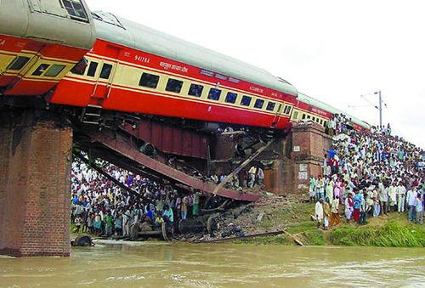
What is Structural Health Monitoring ?
Structural health monitoring system is a method of evaluating and monitoring the health of critical structures.
Its ability to respond to detrimental structural changes, enhancing structural reliability, and improving life cycle management.
It gives real-time analysis of structure.
Rafi Ganj Bridge collapse

Slide 3
Important Aspect of SHM
Mechanical: Strain, Deformation, displacement, cracks opening, stress, load
II. Physical: Temperature, humidity, pore pressure
III. Chemical: Chloride Penetration, sulphate penetration, pH, carbonatation penetration, rebar oxidation, steel oxidation.

Slide 4
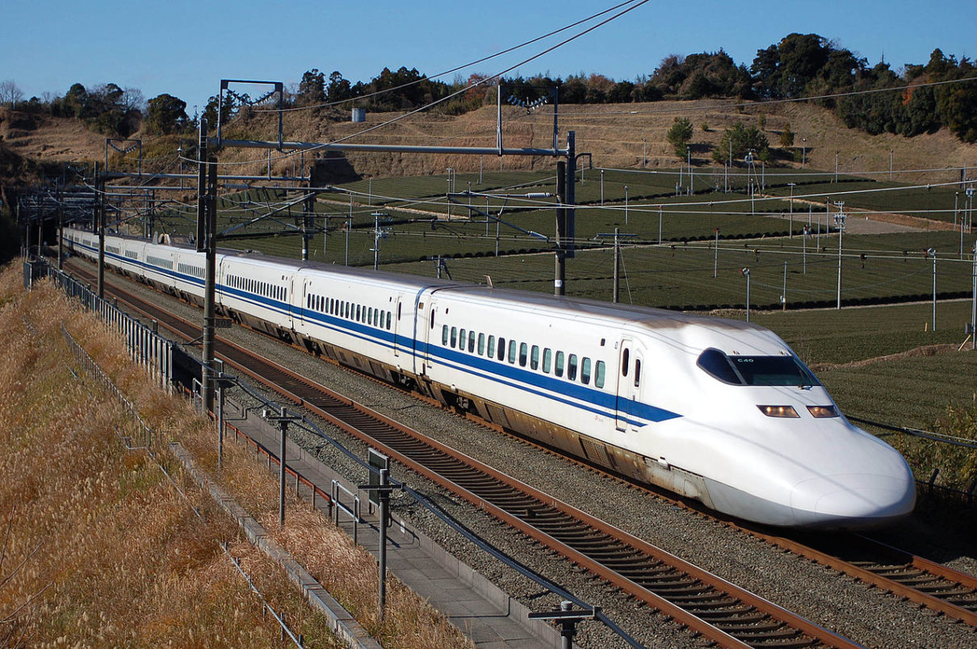

Need of SHM in India
Residential Buildings and Commercial Structures in India have received very less almost inexistent focus on structural health monitoring primarily due to owners not knowing about its availability and poor knowledge about them.
Dams serves special purposes in country. There appears to be a communication gap between the officer-in-charge of design / construction and officers who take over maintenance.
Bridges are important lifeline structures. It is important for them to have elaborate inspection and maintenance programs

Slide 5
Methodology to perform SHM :-
Visual Inspection
Measurement of the Structure(taking frame structure only)
Drawing Detailed AutoCAD Drawing
Analysis Structure on Etabs using I.S code Parameter
Reduce the strength by 10% as it is old Building
Now, Perform NDT test using Rebound hammer and Compare the strength.
Using UPVM on doubt full place to find hidden cracks in structure.
Using numerical stimulation , we find remaining age of structure

Slide 6
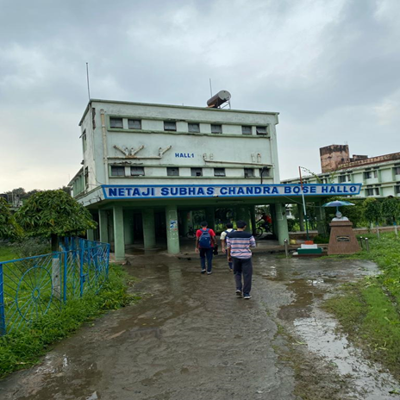
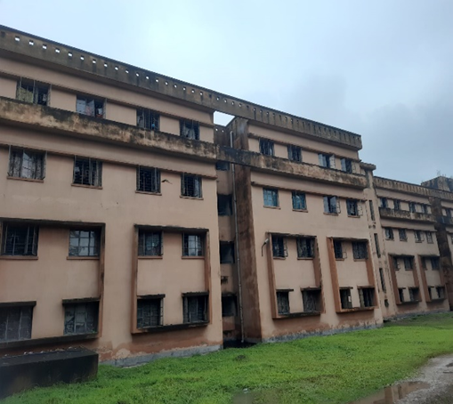
About Hall 1
It is One of the oldest Hostel in NIT DURGAPUR which is named as NETAJI SUBHAS CHANDRA HALL OF RESIDENCE. Hall 1 having accommodation of 420 students
Currently, Final year staying here.
Building has divided into 3-Blocks

Slide 7
Why we need to analyses Hostel ?
Safety of Occupants: The primary concern is the safety of the people living in the hostel.
Quality Assurance: helps you in assessing the quality of your structure during construction, operation, maintenance and repair.
Complex Structures are well managed: Learning how a structure performs in real conditions will help you to design better structures for the future.
To Ensure safety of people, nature and property: Early detection of performance degradation can save lives.
Monitoring reveals hidden resources

Slide 8
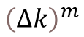
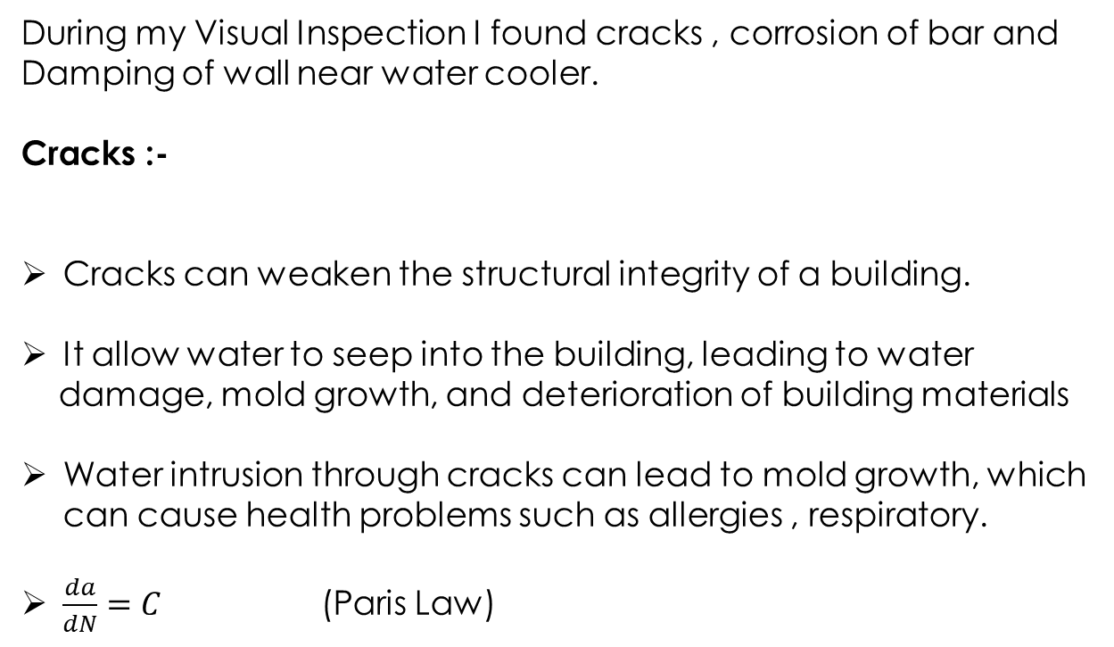
Visual Inspection of Hall 1
During my Visual Inspection I found cracks , corrosion of bar and Damping of wall near water cooler.
Cracks :-
Cracks can weaken the structural integrity of a building.
It allow water to seep into the building, leading to water
damage, mold growth, and deterioration of building materials
Water intrusion through cracks can lead to mold growth, which can cause health problems such as allergies , respiratory.
$\frac{da}{dN}=C$ (Paris Law)
$${\left(Δk\right)}^{m}$$

Slide 9
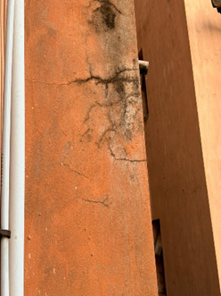
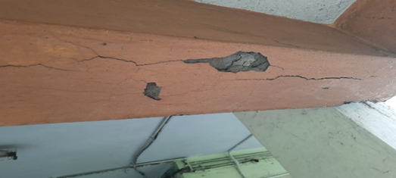
Cracks in Beam Joints
Exterior joints

Slide 10
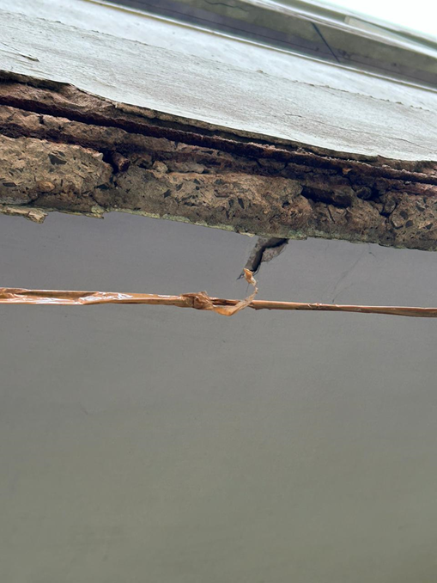
Corrosion of Bars
corrosion can equally impact the structural performance.
Steel corrosion may result in reduced flexural capacity (loss of rebar cross section), reduced bond, and limited ductility

Slide 11
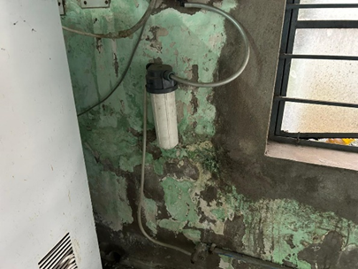
Water Damping
Water damage can cause structural damage to your property, such as warped or cracked walls and ceilings.
Water can compromise your property's framing, weaken support beams, and lead to other safety hazards.

Slide 12
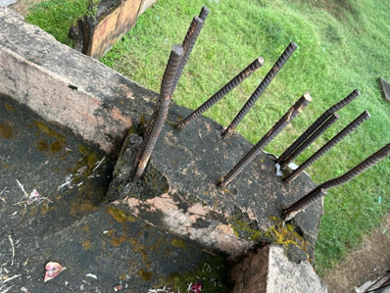
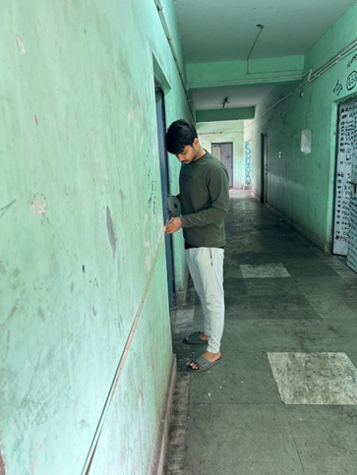
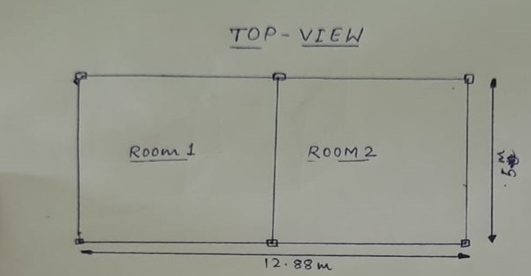
Dimension of Hall 1 Extension room
Extension is a 4 storey-building.
Height of Each storey:- 3m
Slab Thickness:- 250 mm
Column:- 400mm X 500mm
Beam:- 250 mm X 350 mm
Room size:- 6.25m X 4.7 m
Outer wall Thickness: - 25.4 cm
Inner wall Thickness: - 12.5 cm
Gallery width: - 1.9 m
Balcony width:- 2.8m X 5.1 m
Clear cover of column :- 50mm
Taking measurement

Slide 13
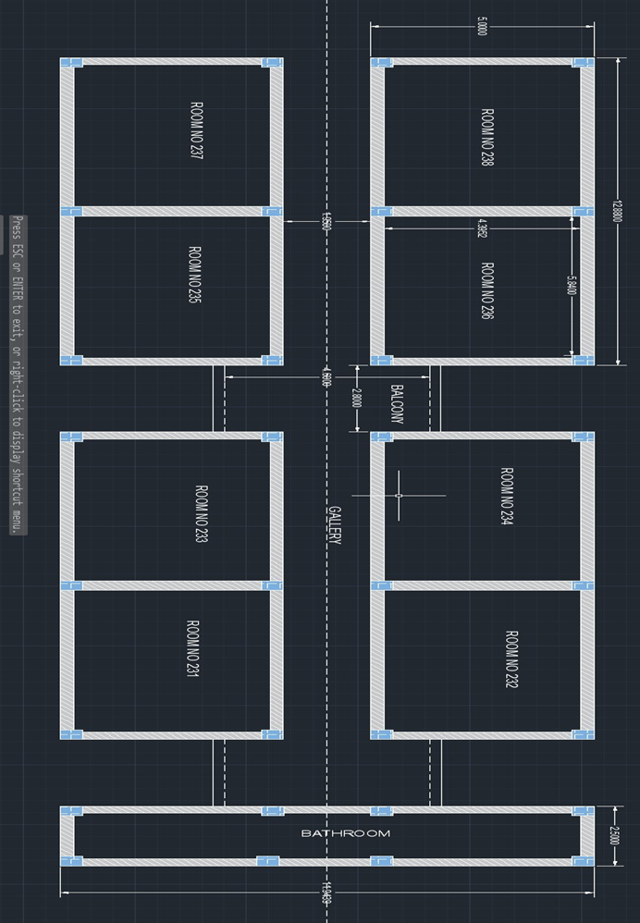
AUTOCAD DRAWING
Top View

Slide 14
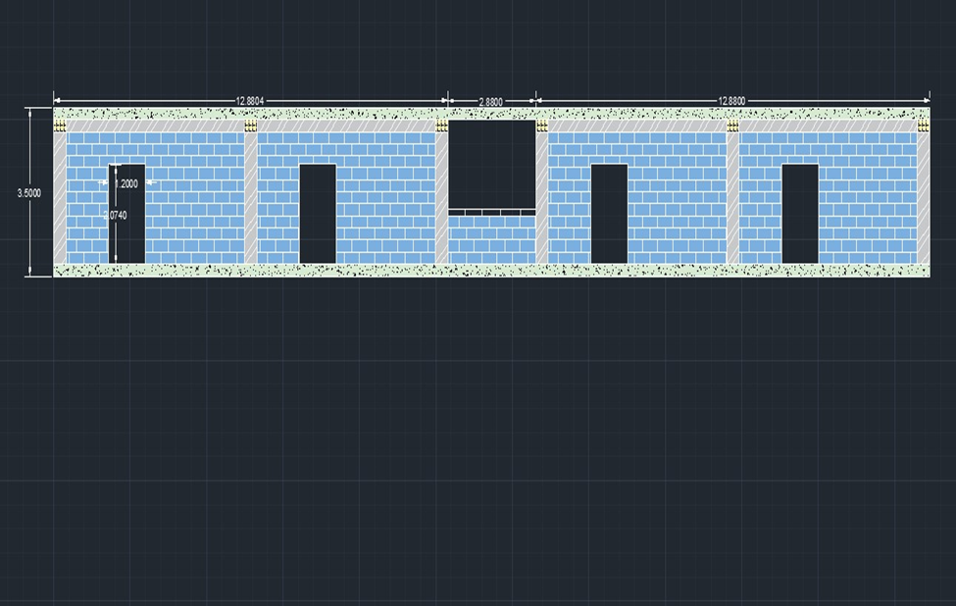
Cross Sectional View

Slide 15
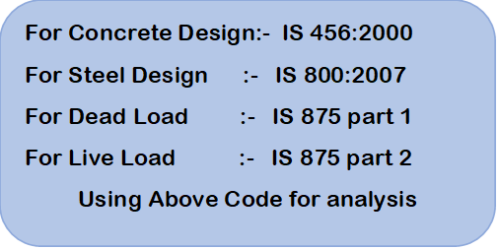
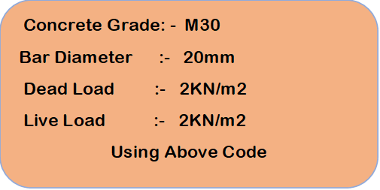
Etab Analysis

Slide 16
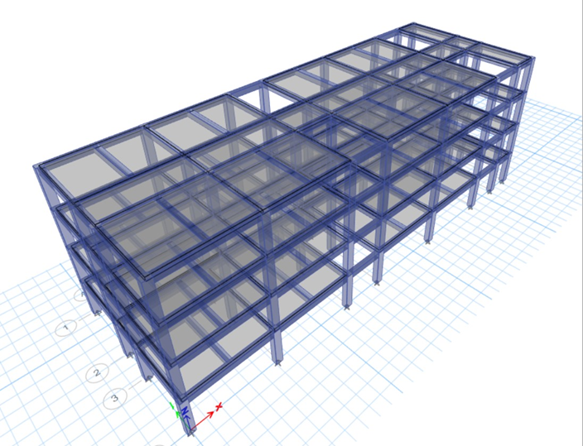
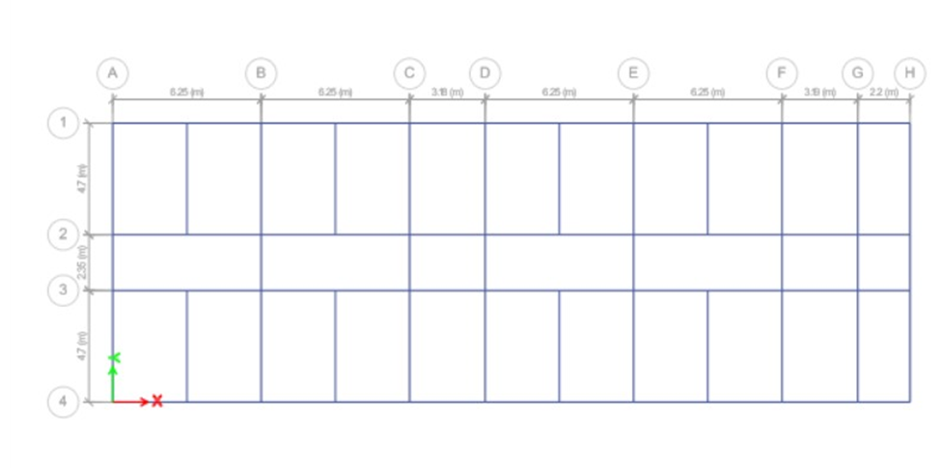
Grid View
Extruded View

Slide 17
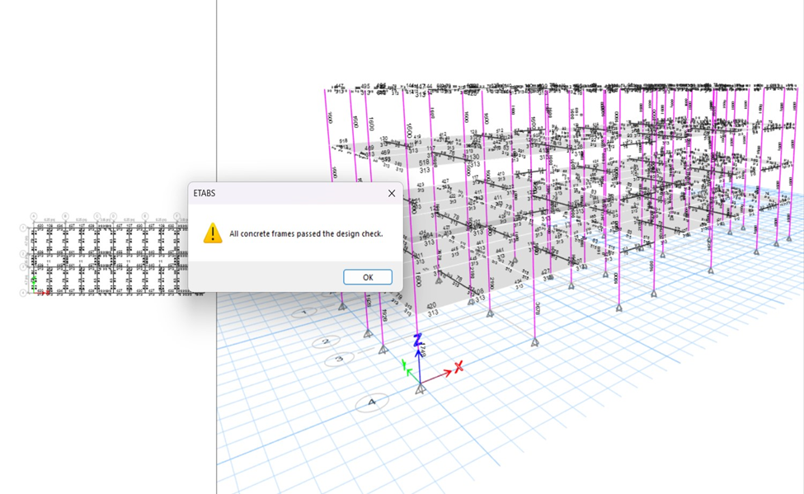
All Frame Checking

Slide 18
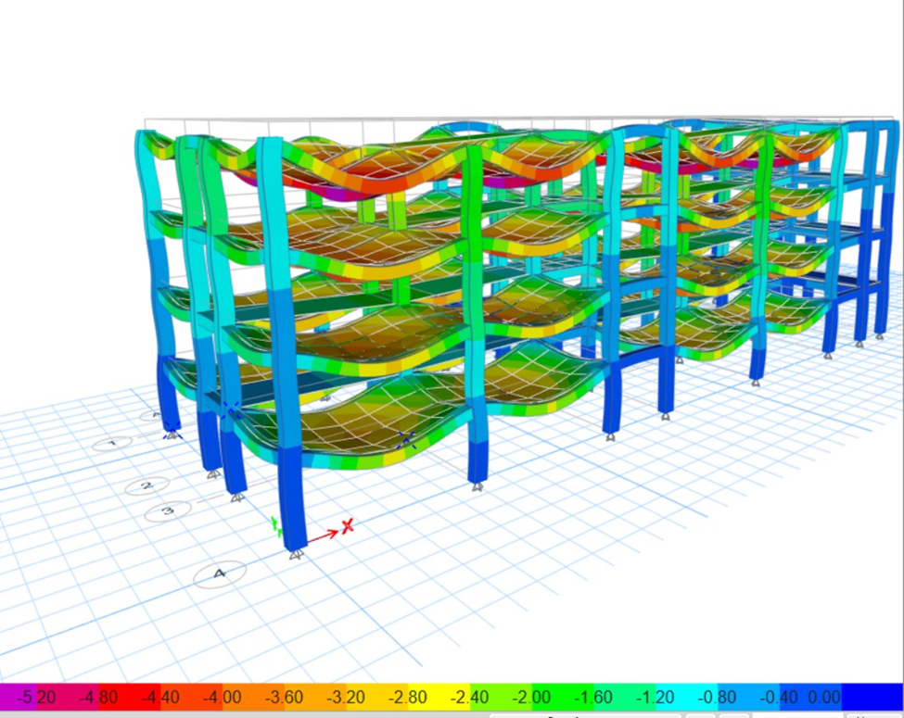
Deformation of Structure in mm
Maximum Deformation throughout span is 5.20mm.
According IS code 456:2000 clause 23.2 maximum deflection is not greater than
20 mm > 5.20mm (so, it’s okay)
Our Analysis Pass successfully.

Slide 19
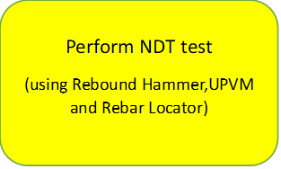
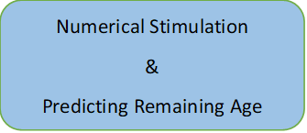
Future Plan

Slide 20
Conclusion
This is very interesting project for me like exploring new things such as examine the Structure using SHM techniques , Etabs and NDT instrument. In this project,
My Structure design is passed and maximum deflection is in safe zone and all frames are passed. I learnt how to inspect a building visually and check the design using Etabs software.

Slide 21
References
1. A Dire Need of India by Gajanan M. Sabnis , Gopal Rai
mailto:https://www.dgc24.com/dgc_infra/en/wp-content/uploads/2014/07/Structural-Health-Monitoring-Dire-Need-India-21st-SHM.pdf
2. Analytical Structural Health Monitoring of Shear Wall Building by Md Naseem Rangrez, Misbah Danish Sabri
mailto:https://doi.org/10.22214/ijraset.2022.45934
3. Prediction of Remaining useful life for fatigue-damaged structures using Bayesian interference
By Jaydeep M. karandikar , Nam Ho Kim
www.elsevier.com/locate/engfracmech

Slide 22
Thank You

